Slide 1
Arrays and Strings
Md. Ariful Islam Khandaker
Assistant Professor
IICT, KUET

Slide 2
Array
An array is a group of related data items that share a common name.
For instance, we can define array name salary to represent a set of salary of a group of employees.
int salary [ 5 ];
[ 0 ]
[ 1 ]
[ 2 ]
[ 3 ]
[ 4 ]
salary
1000
50000
5000
7000
salary [ 0 ] = 1000;
salary [ 1 ] = 50000;
salary [ 2 ] = 5000;
salary [ 3 ] = salary [ 0 ] + salary [ 2 ] + 1000;

Slide 3
Initialization of Arrays
The general form of initialization of arrays is:
static type array-name [size] = {list of values};
Eg: 1) static int number[3] = { 20, 25 };
number
[0]
20
[1]
30
[2]
0

Slide 4
Initialization of Arrays(Continue)
static int number[3] = {0,0};
If the number of values in the list is less than the number of elements, then only that many elements will be initialized.
The remaining elements will be set to zero automatically.
Initialization of arrays in C suffers two drawbacks :
There is no convenient way to initialize only selected elements.
There is no shortcut method for initializing a large number of array elements like the one available in FORTRAN

Slide 5
A simple Array Program
#include <stdio.h>
#include <conio.h>
int main ( )
{
int i , a[5] , n;
clrscr ( );
printf ( “ How many numbers\n”);
scanf ( “ %d”, & n);
for ( i = 0; i< n; i ++ )
{
scanf ( “ %d “, & a[ i ]);
}
printf ( “ Reverse order of the numbers\n” );
for ( i = n -1; i >=0 ; i - - )
{
printf ( “ %d “, a [ i ] );
}
getch ( );
return 0;
}
[0]
10
n = 5
[1]
20
a [ 0 ] = 10;
a [ 1 ] = 20;
[2]
30
a [ 2 ] = 30;
a [ 3 ] = 40;
[3]
40
a [ 4 ] = 50;
[4]
50
i = 5 – 1 = 4
a
Output
50
40
30
20
10
a[4]
a[3]
a[2]
a[1]
a[0]

Slide 6
Array Program
Write a program which will sum a list of values given by the user.
[ 0 ]
[ 1 ]
[ 2 ]
[ 3 ]
[ 4 ]
[ 5 ]
x
10
20
30
40
50
60
sum
10
X [ ]
30
60
100
150
210
0
= sum
10
30
60
100
150
0
+
0
1
2
3
4
5
10
40
60
50
20
30
sum = 0;
for ( i =0; i<=5; i++)
{
sum = sum + x [ i ];
}
printf ( “ Total = %d”, sum) ;

Slide 7
Example Program
int main()
{
int i;
float x[10],value, total;
printf(“Enter 10 real numbers:\n”);
for(i =0; i < 10; i++)
{
scanf(“%f”,&value);
x[i] = value;
}
total = 0.0;
for(i = 0; i < 10; i++) {
total = total + x[i] * x[i]; }
printf(“\n”);
for(i = 0; i < 10; i++) {
printf(“x[%d] = %5.2f \n”,i+1,x[i]); }
printf(“\nTotal = %.2f\n” ,total);
return 0;
}
OUTPUT
Enter 10 real numbers:
1.1 2.2 3.3 4.4 5.5 6.6 7.7 8.8 9.9 10.10
x[1] = 1.10
x[2] = 2.20
x[3] = 3.30
x[4] = 4.40
x[5] = 5.50
x[6] = 6.60
x[7] = 7.70
x[8] = 8.80
x[9] = 9.90
x[10] = 10.10
Total = 446.86

Slide 8
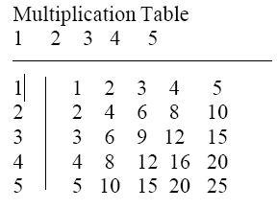
TWO-DIMENSIONAL ARRAYS
Two-dimensional arrays are declared as follows
type array-name[row_size][column_size];
Eg: product[i][j] = row * column;
Two-dimensional arrays example “Multiplication Table” as follows

Slide 9
Multiplication Table Program
#define ROWS 5
#define COLUMNS 5
void main() {
int row, column, product[ROWS][COLUMNS], i, j ;
printf(“Multiplication table\n\n:”) ;
for(j = 1; j <= COLUMNS; j++)
printf(“%4d”, j);
printf(“\n”);
for(i = 0; i < ROWS; i++) {
row = i + 1;
printf(“%2d|”, row);
for(j =1; j <= COLUMNS; j++)
{
column = j;
product[i][j] = row * column;
printf(“%4d”, product[i][j]);
}
printf(“\n”);
}
}

Slide 10
MULTIDIMENSIONAL ARRAY
C allows arrays of three or more dimensions. The exact limit is determined by the compiler.
The general form of a multidimensional array is
type array_name[s1][s2][s3]…s[m];
Eg:
1. int survey[3][5][12];
2. float table[5][4][5][3];

Slide 11
Passing Arrays to Functions
Array elements can be passed to a function by calling the function by value, or by reference
In the call by value we pass values of array elements to the function
In the call by reference we pass addresses of array elements to the function
As we did not see call by reference yet, we will see that later

Slide 12
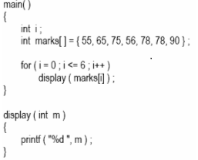
Passing Arrays to Functions

Slide 13
Output

Slide 14
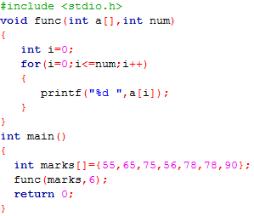

Slide 15
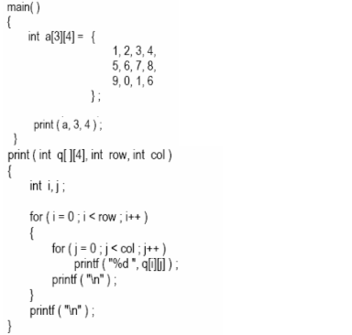
Passing Arrays to Functions

Slide 16

Output

Slide 17
String
A string is a array of characters.
Any group of characters(except the double quote sign) defined between double quotation marks is a constant string.
Eg: 1) “Man is obviously made to think”
Eg: printf(“\”well done!\””);
NOTE: String must end with NULL (‘\0’)character.

Slide 18
Operation on String
The operations that are performed on character strings are
Ø Reading and writing strings.
Ø Combining strings together.
Ø Copying one string to another.
Ø Comparing strings for equality.
Ø Extracting a portion of a string.

Slide 19
DECLARING AND INITIALIZING STRING VARIABLES
A string variable is any valid C variable name and is always declared as an array.
The general form of declaration of a string variable is
char string_name[size];
Eg: char city[10];
static char city[9] = “NEW YORK”;
static char city[9] = {‘N’, ‘E’, ‘W’, ‘ ‘, ‘Y’, ‘O’, ‘R’, ‘K’, ‘\0’};

Slide 20
Reading Words
The familiar input function scanf can be used with %s format specification to read in a string of characters.
main()
{
char word1[40], word2[40], word3[40], word4[40];
printf(“Enter text:\n”);
scanf(“%s %s”,word1, word2);
scanf(“%s”, word3);
scanf(“%s”,word4);
printf(“\n”);
printf(“word1 = %s \n word2 = %s \n”,word1, word2);
printf(“word3 = %s \n word4 = %s \n”,word3, word4);
}
OUTPUT
Enter text:
Oxford Road, London M17ED
Word1 = Oxford
Word2 = Road
Word3 = London
Word4 = M17ED

Slide 21
Reading a Line of Text
It is not possible to use scanf function to read a line containing more than one word.
main()
{
char line[81],character;
int c;
c = 0;
printf(“Enter text. Press<Return>at end \n”);
do
{
character = getchar();
line[c] = character;
c++;
}while(character != ‘\n’);
c = c-1;
line[c] = ‘\0’;
printf(“\n %s \n”,line);
}
OUTPUT
Enter text. Press<Return>at end
Programming in C is interesting
Programming in C is interesting

Slide 22
About String
The C library supports a function that converts a string of digits into their integer
values. The function takes the form
x = atoi(string)
Just as we cannot assign one string to another directly, we cannot join two strings together by the simple arithmetic addition. That is, the statements such as
string3 = string1 + string2;
string2 = string1 + “hello”;
are not valid.
C does not permit the comparison of two strings directly.
if(name1 == name2)
if(name == “ABC”);
are not permitted.

Slide 23
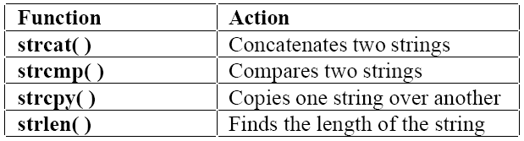
STRING - HANDLING FUNCTIONS
C library supports a large number of string-handling functions that can be used to carry out many of the string manipulation activities.
Another string handling function is available, i.e
strrev( ) Reverse any String
For using these functions we have to include string.h header file

Slide 24
strcat( ) Function
The strcat function joins two strings together. It takes the following form
strcat( string1, string2);
Eg: strcat(part1, “GOOD”);
strcat(strcat(string1,string2),string3);
Here three strings are concatenated and the result is stored in string1.

Slide 25
strcpy( ) Function
This function works almost like a string assignment operator. It takes the form
strcpy(string1,string2);
This assigns the content of string2 to string1.
Eg: 1) strcpy(city, “DELHI”);
2) strcpy(city1,city2);

Slide 26
strlen( ) Function
This function counts and returns the number of characters in a string.
n = strlen(string);
Example:
int x;
x = strlen(“KUET”);
The value of x will be 4

Slide 27
strcmp( ) Function
It is used to compare two strings identified by the arguments and has a value 0 if they are equal. It takes the form:
strcmp(string1,string2);
Eg: 1) strcmp(name1,name2);
2) strcmp(name1,”john”;
3) strcmp(“ram”, “rom”);

Slide 28
Using gets( )
Limitation of scanf( ) : scanf( ) function can not able to take space as input.
Example of gets ( )
#include <stdio.h>
int main () {
char str[50];
printf("Enter a string : ");
gets(str);
printf("You entered: %s", str);
return(0);
}

Slide 29
Concatenation without strcat( )
#include<stdio.h>
int main(){
char str1[25],str2[25];
int i=0,j=0;
printf("\nEnter First String:");
gets(str1);
printf("\nEnter Second String:");
gets(str2);
while(str1[i]!='\0')
i++;
while(str2[j]!='\0') {
str1[i]=str2[j];
j++;
i++; }
str1[i]='\0';
printf("\nConcatenated String is %s",str1); return 0;}

Slide 30
Program
#include<string.h>
main( ) {
char s1[20],s2[20],s3[20];
int x, l1, l2, l3;
printf(“Enter two string constants \n”);
scanf(“%s %s”, s1, s2);
x = strcmp(s1, s2);
if(x != 0) {
printf(“Strings are not equal \n”);
strcat(s1, s2); }
else{
printf(“Strings are equal \n”); }
strcpy(s3,s1);
l1 = strlen(s1);
l2 = strlen(s2);
l3 = strlen(s3);
printf(“\ns1 = %s \t length = %d characters \n”,s1, l1);
printf(“\ns2= %s \t length = %d characters \n”,s2, l2);
printf(“\ns3 = %s \t length = %d characters \n”,s3, l3); }
OUTPUT
Enter two string constants
New York
Strings are not equal
s1 = New York length = 7 characters
s2 = York length = 4 characters
s3 = New York length = 7 characters
Enter two string constants
London London
Strings are equal
s1 = London length = 6 characters
s2 = London length = 6 characters
s3 = London length = 6 characters

Slide 31
Thank you

